Slide 1
HackAthon ProJECT presentation
Topic – Indentify New Bikes.

Slide 2
Team members:
Name | Employee Id
Jenil Juin DJ | 2151265
Kavin Bharathi T K | 215155
Kishore Mettukadai Thiyagarajan | 2150963
Nithya Niranjan T P | 2151163
Sridhar S | 2151271

Slide 3
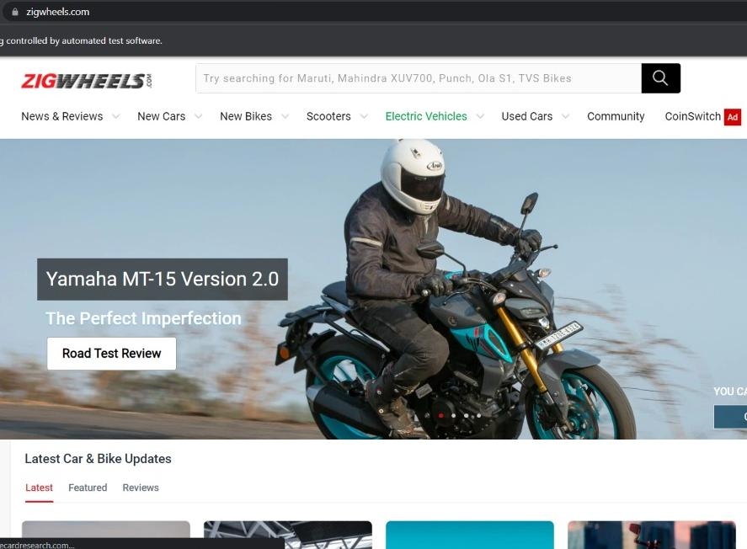
Website: http:// www.Zigwheels.com

Slide 4
Tools and Technology used:
1.Selenium with Java in eclipse:
Selenium is A protable framework for testing web application. It provides playback tool for authoring functional tests.
2. TestNG:
TestNG is the testing framework for the Java programming language credited by Cedric Beust and inspired by JUnit and NUint.
3. Maven:
Maven is a build automation tool used primarily for Java projects.
4. POM with POI:
A project object model Or POM is the fundamental unit of work in Maven.It is a XML file work that contains information about the project.

Slide 5
Work done:
1. The code is written in Java and automated in different browsers with the help of selenium. The project and the dependies are managed with the help of maven
2. POM is used to create classes for each page therefore reducing the use of same code for various objects
3. Input data is obtained from Properties files and from Excel sheetswith the help of Apache POI.

Slide 6
Requirements and Execution steps:
Try to login with google, give Invalid account details and capture the error message.
Click to login button in homepage.
login to google with invalid credentials and capture the screenshot of write the error message in extend report.
Display upcoming bikes details like names, price and expected launch date in India for manufacturer honda and price less than 4Lac
Display New Bikes from honda manufacturers
Search in search bar
Display upcoming bikes less than 4Lac and also under 2Lac by sorting them in array and list in excel sheet.
For used cars in Chennai extract all the popular models in list , Display the same.
Go to user cars drop down and selected the following cities: Chennai .
Extract the display options and written them in the excel sheet.

Slide 7
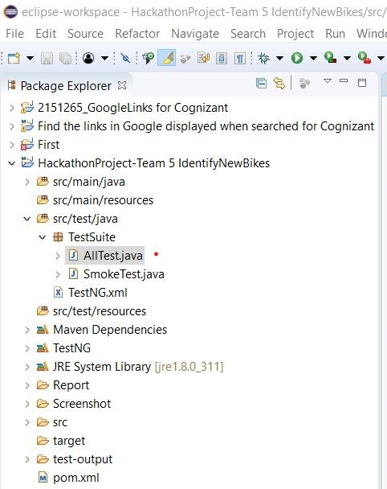
Project structure:

Slide 8
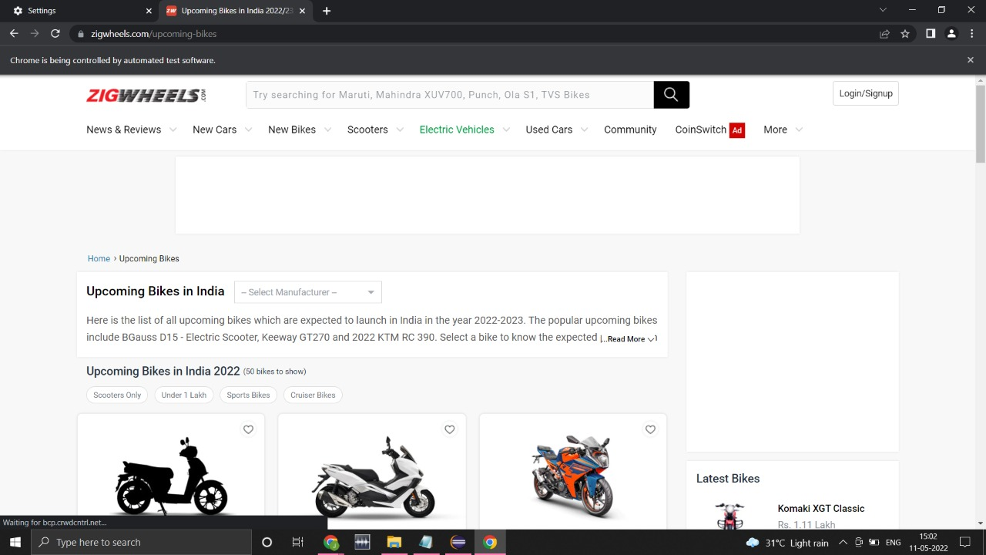
Screenshots
Upcoming Bikes in India

Slide 9
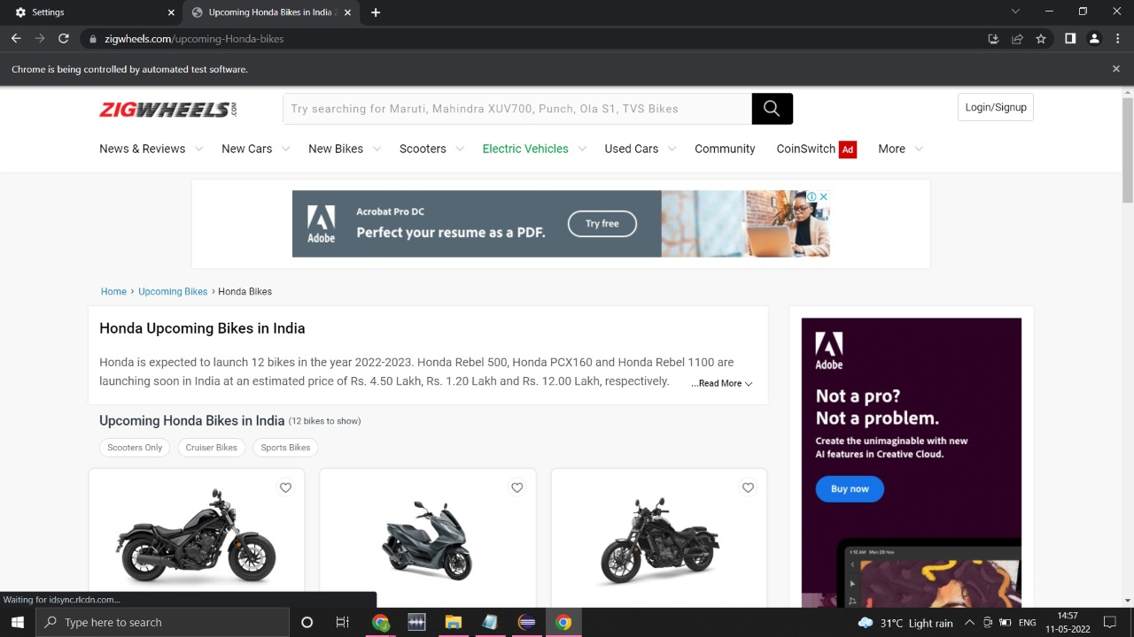
Honda Upcoming Bikes in India

Slide 10
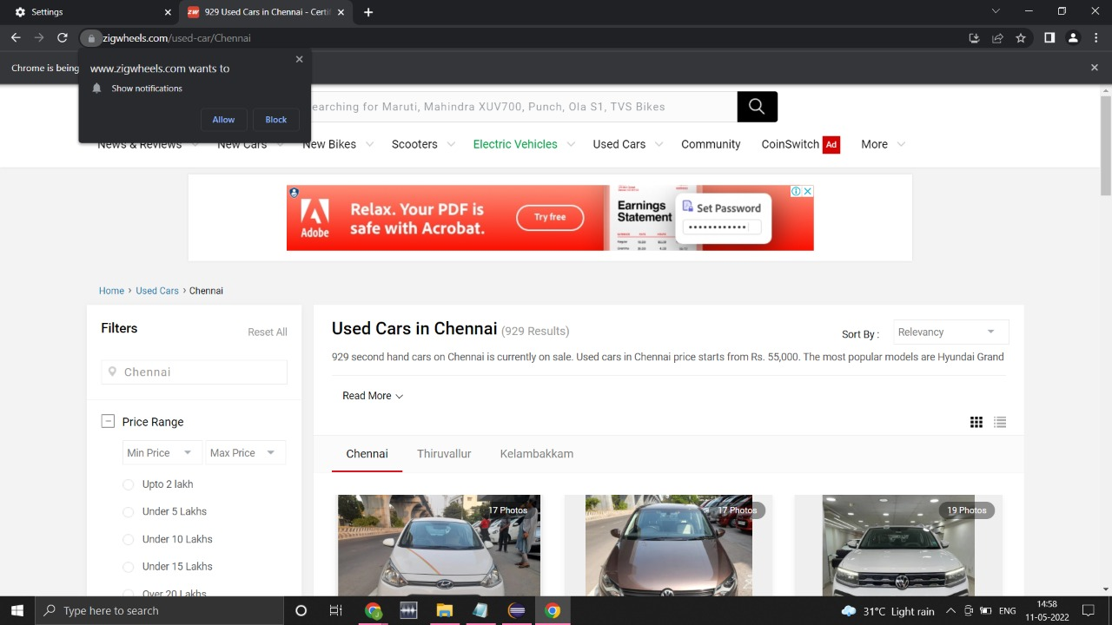
Used Cars in Chennai

Slide 11
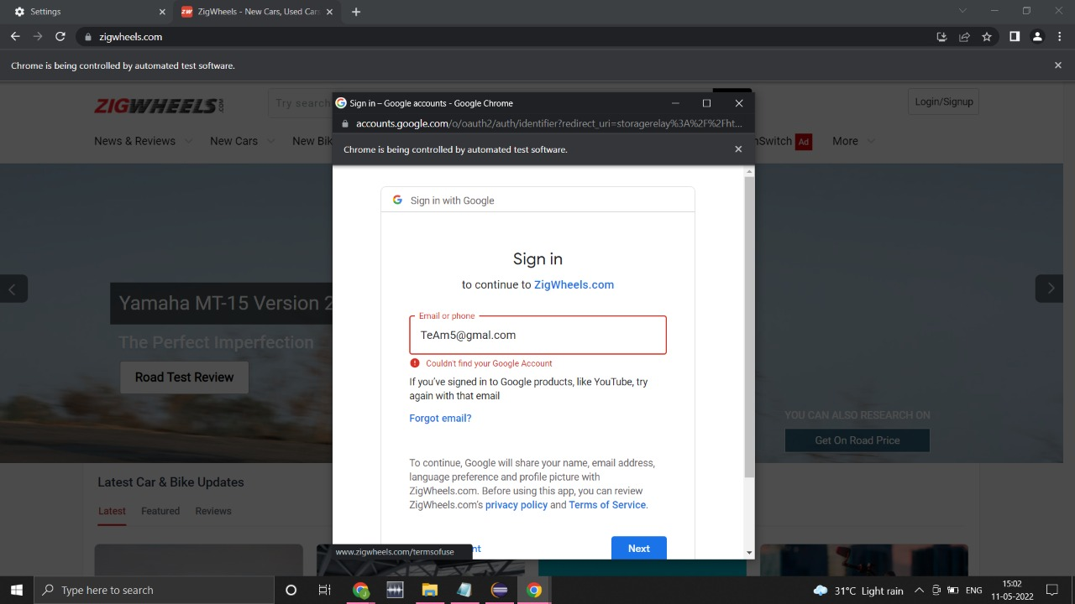
Login with Invalid email and shows error message

Slide 12
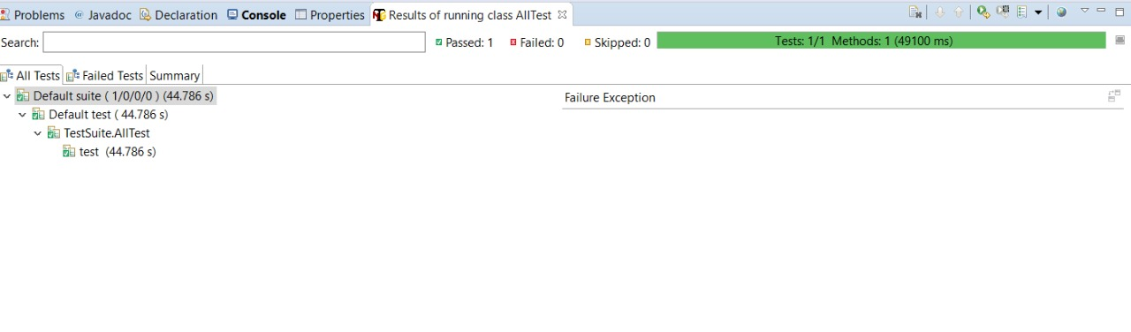
Test Case Passed

Slide 13
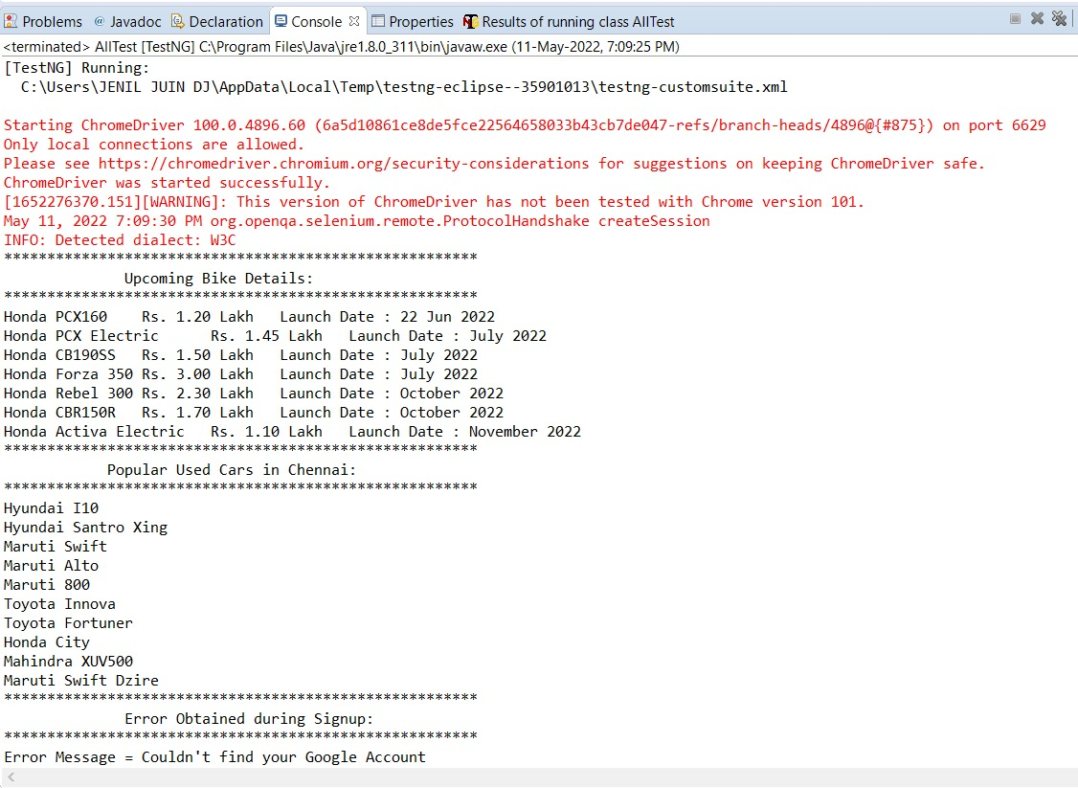
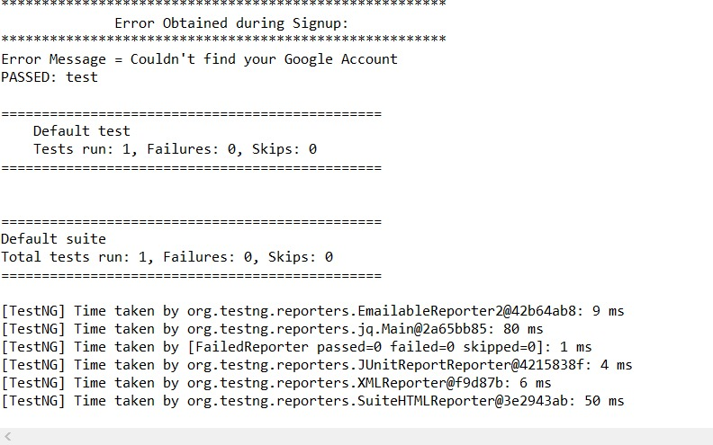
Console (Output)

Slide 15
Thank you

